Slide 1
Introduction To Roslyn
Brian Korzynski

Slide 2
About Me
Lead Developer at UseTech Design L.L.C. (UTD)
A consulting firm based in Troy, MI
http://www.utdes.com
Professional Developer for 6+ years
Windows Forms
Web
Mobile
SQL Optimization
Data Analysis
Mathematics
Big Data

Slide 3

What is Roslyn?
Notes:
Rosslyn Church - http://pagepark.co.uk/assets/uploads/projects/xlarge/RC_2_20140410100027.jpg

Slide 4
What is Roslyn?
Definition: the .NET Compiler Platform which provides open-source C# and Visual Basic compilers with rich code analysis API’s.
C# and Visual Basic we built on old technology and just like any code base that has been around for a long time, was getting harder to maintain and add new features.
Microsoft created Roslyn as a way to quickly add new language features and share them across C# and Visual Basic
So they figured why not open source it and make it available to everyone

Slide 5
What does it mean to us?
We can add our own language features
“With great power comes great responsibility”
Don’t recommend doing this unless you are planning to submit a pull request into C# since

Slide 6
What do You Need To Get Started?
Install-Package Microsoft.CodeAnalysis –Pre
g

Slide 7
Where Does the Compiler Fit In

Slide 8

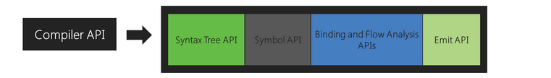

Components

Slide 9
Code Analyzers

Slide 10
Code Analyzers vs. RegEx

Slide 11
Current Usage
You can write code analyzers to throw your own warnings or error messages at compile time.
Allows you to enforce coding standards

Slide 12
Future Usage
FxCop – flip a flag in the solution and it will automatically throw FxCop errors
Change code to abide by FxCop standards, since some new features are a violation
Compiler as a NuGet package?

Slide 13
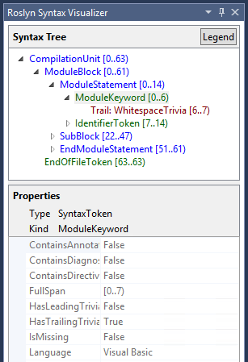
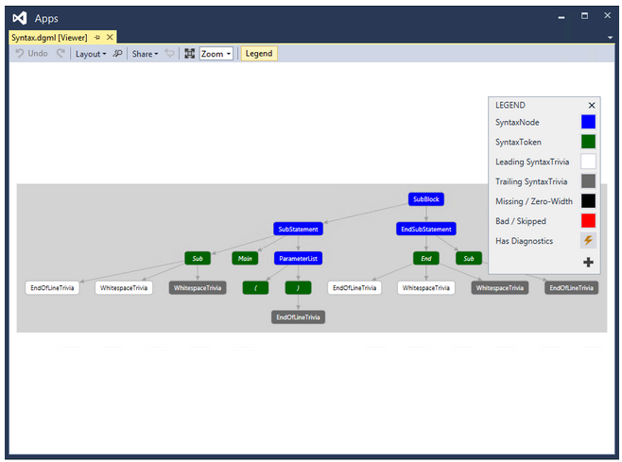
Syntax Visualizer

